Slide 1

AUTOMATED RESUME BUILDER
GROUP MEMBERS:-
1. MAYANK KUMAR_21107016
2. JANHAVI KASAR_21107030
3. SANSKRUTI CHAVAN_21107047
4. DALBIRSINGH MATHARU_21107005
Project Guide
Prof. ANAGHA AHER
Notes:
1

Slide 2
1. Introduction
Automated Resume Builder is the application which helps user to get their resume in hand just by filling up personal, educational, and technically information.
Problem Identified :
Building a resume is a hectic and time consuming work for job seeking candidates.
Finding out a proper professional layout
Solution Proposed :
It provides the user with eye catching and well structured professional resume layout.
The system provides instant result.
Notes:
2

Slide 3
2. Objectives
To reduce the thinking of user towards the hectic resume work.
To make available the professional resume(using netbeans IDE and MySQL)
To make you stand out in this competitive world by filling your information in a proper manner and in a more professional way in the layout.
To build a tool that often constitutes an automated process in which you follow a template and input your information.
Notes:
3

Slide 4
3. Scope
Can be useful for students and job seeking applicants.
Can be applied while seeking internships or placement areas.
Can be useful while applying for higher studies.
Can be used to introduce skillset and career story.
Notes:
4

Slide 5
4. Feature /Functionality
Feature 1 :
Manage the information and integration of all records of technical skills and education qualifications.
Feature 2 :
It provides with easy to use interface and has a highly customizable and professional template.
Feature 3 :
It provides the option for user to choose between two templates available.
Notes:
5

Slide 6
5. Outcome of Project
User can login with their respective ID and Password.
User needs to fill the required details.
User is provided with a eye catching resume template.
Resume is generated just by clicked the template options
Notes:
6

Slide 7
6. Technology Stack
Jdk version-18.0.2.1
Netbeans IDE version-14
MySQL version-14
Database Used is MySQL
Notes:
7

Slide 8
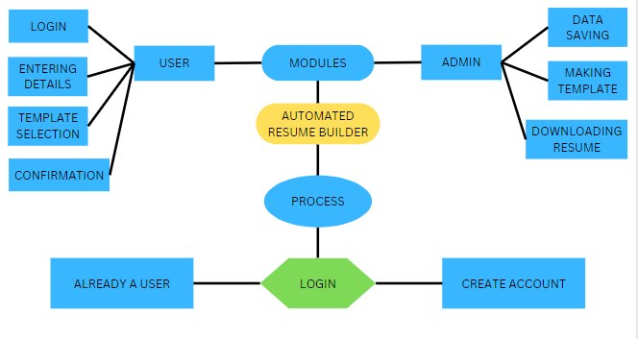
Block Diagram

Slide 9
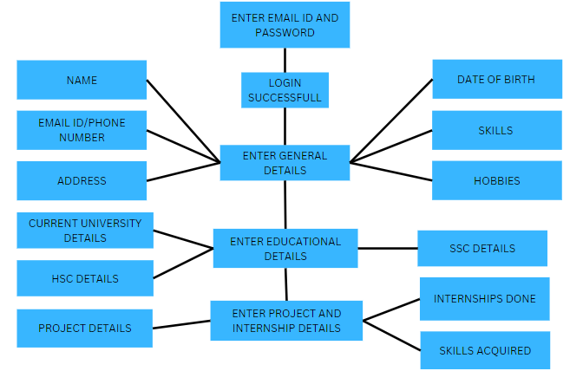

Slide 10
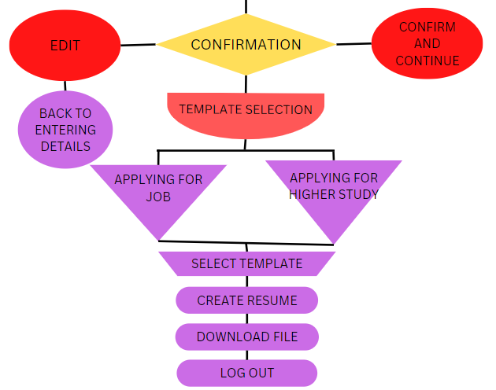

Slide 11
Thank You...!!
Notes:
11

